Slide 1

Delivering real CBM results in IoT4.0 for Industry
Allan Findlow – Managing Director & Founder of Drive Management Services part of the Hayley 247 Engineering Services group of companies

Slide 2

“According to some estimates, the Internet of Things will add $10-$15 Trillion to global GDP in the next 20 years.”
Bernard Marr - Forbes, August 17th 2015

Slide 3


The World is constantly changing
Drive Management Services are a reliability services business, providing condition monitoring services and solutions for traditional industry sectors.
We recognized in 2012 that the way we monitor assets was changing from conventional methods to those which are remote, interactive and non-intrusive.
As a developer of fixed continuous monitoring systems, we believed the future was based on providing a first-class diagnostic service via the web / internet.
In 2017 we partnered with a UK ThingWorx integrator to develop a truly flexible and dynamic IoT solution.
In 2019, DMS launched a new IoT platform named “DMS Asset Minder”, utilizing various sensors to monitor and deliver real time machine asset health.
Technology is affecting our lives from the way to we socially interact, shop for groceries and the way we use artificial intelligence to recreate history.*
Smart sensors are now being fitted on fitness watches, central heating systems, door bell alarms & now in industry on flow meters, pressure sensors, speed, temperature & vibration.
The key to success in all these areas of innovation, is to make the product:-
Easy to operate
Simple to install
Cost effective / value for money
This is the challenge facing us, every day in the world of predictive maintenance.
*Bernard Marr - Forbes, August 17th 2015

Slide 4
What is the Internet of Things?
The Internet of Things(IoT) is the network of physical objects, devices, vehicles, buildings and other items which are embedded with electronics, software, sensors, and network connectivity, which enables these objects to collect and exchange data.
The Internet of Things allows objects to be sensed and controlled remotely across an existing network infrastructure, creating opportunities for more-direct integration between the physical world and computer-based systems, resulting in improved efficiency, accuracy and economic benefit.It is estimated that IoT will consist of almost 50 billion objects by 2020.
The world of IoT will enable us as a specialist business to transition very easily from the predictive phase into the prescriptive phase.

Slide 5

The Challenge & Requirements
DMS were invited to work with a UK specialist fuel pumping company to closely monitor and assess the performance of their critical multi-stage pumps.
Following a number of serious failures in the last 12 months on a number of their UK sites, the client decided that they needed to find a better solution and somehow implement a reliable live condition-based monitoring system with full diagnostic support. This was the challenge that they set DMS.
The client was looking for the following requirements:
Continuous “24 hours a day” monitoring
Multi-level complex alarms
Wireless communication
ATEX environment hardware
Remote diagnostics delivered in “real time”
Automated alerts

Slide 6
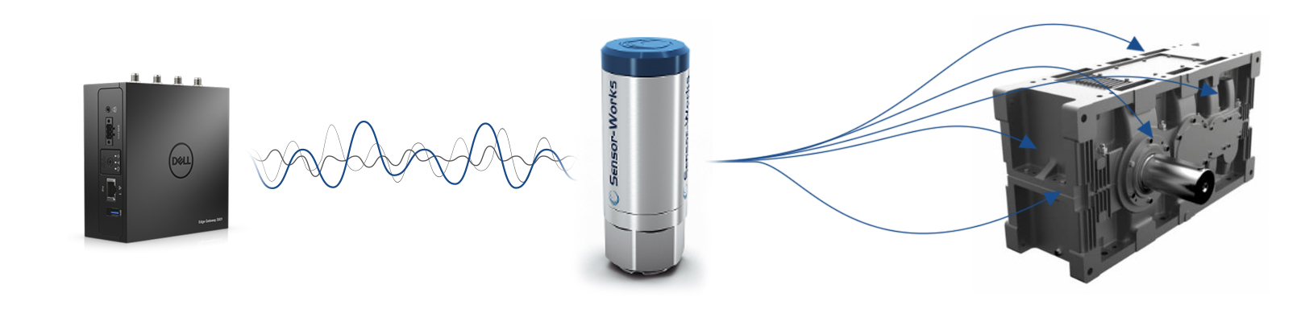

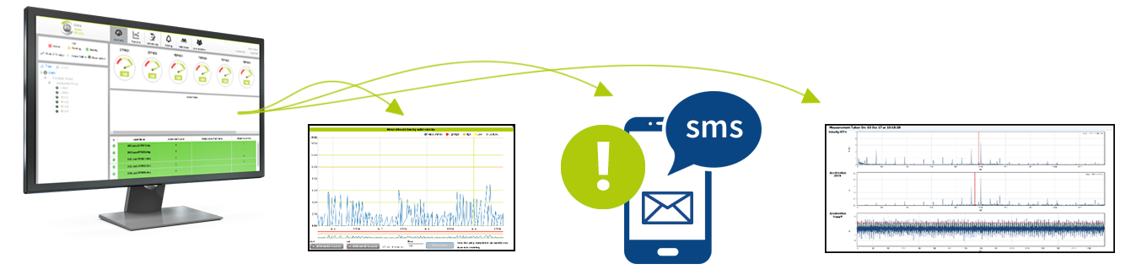
MachineGuard The Future but Now!
Gateway & Enclosure
Bluetooth Accelerometer
Asset
View Trends
View Spectra
Notes:
Blue Tooth to Bluetooth

Slide 7
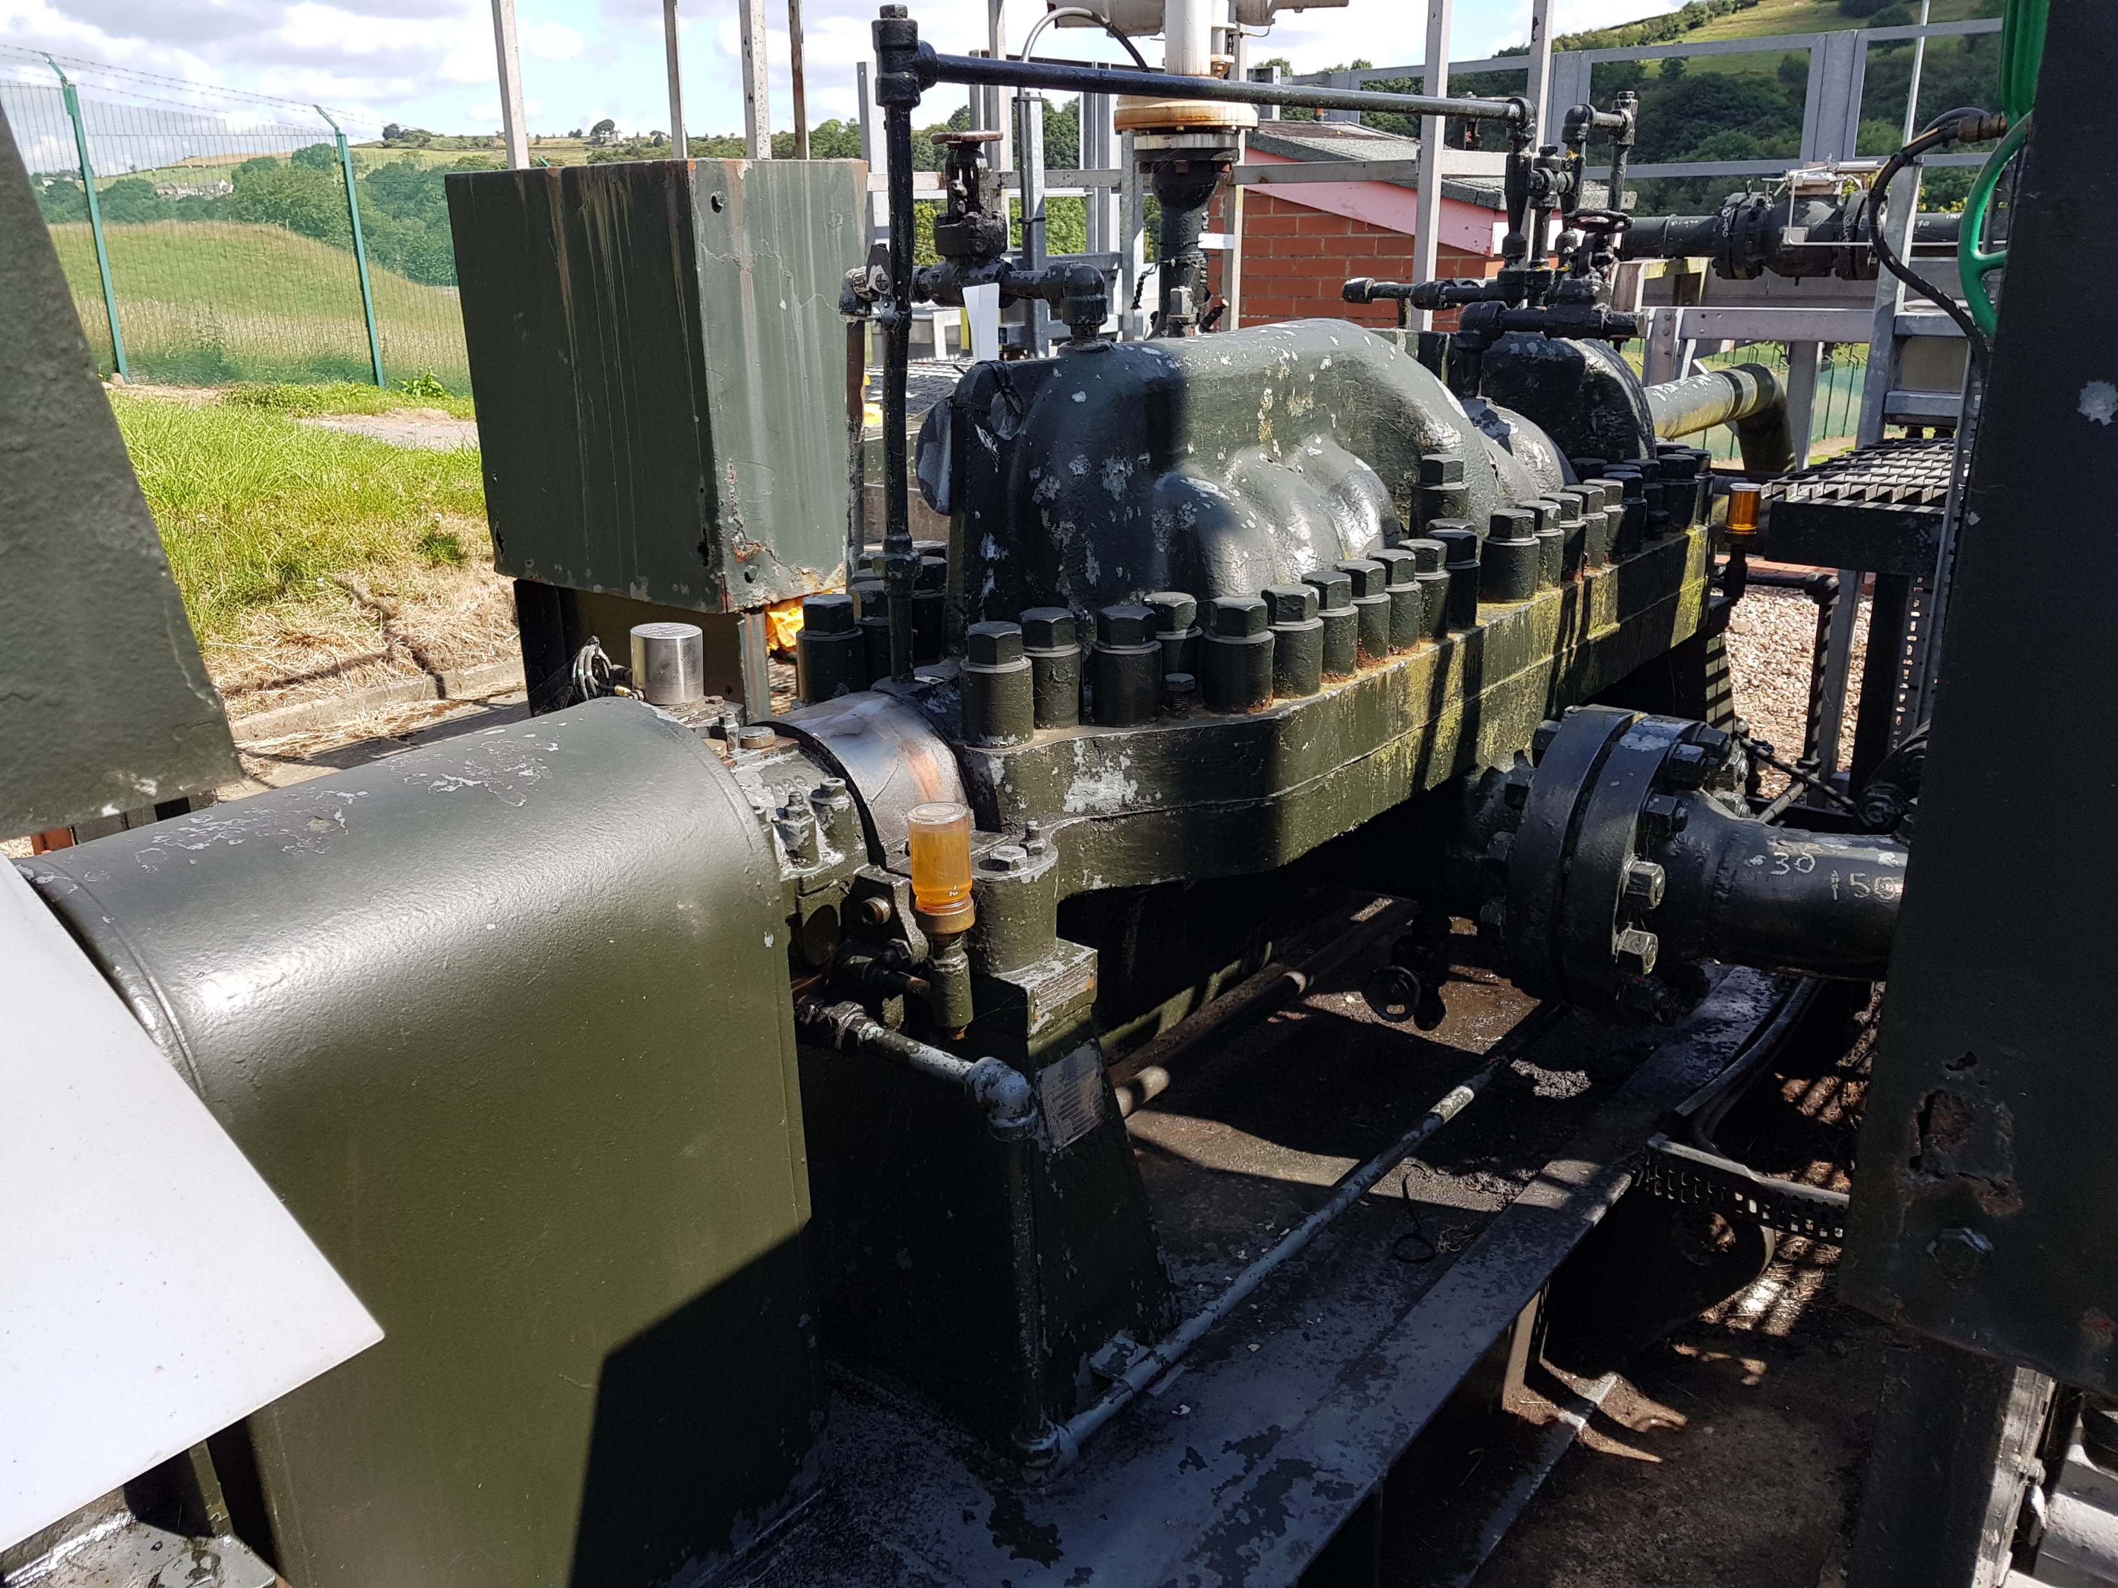
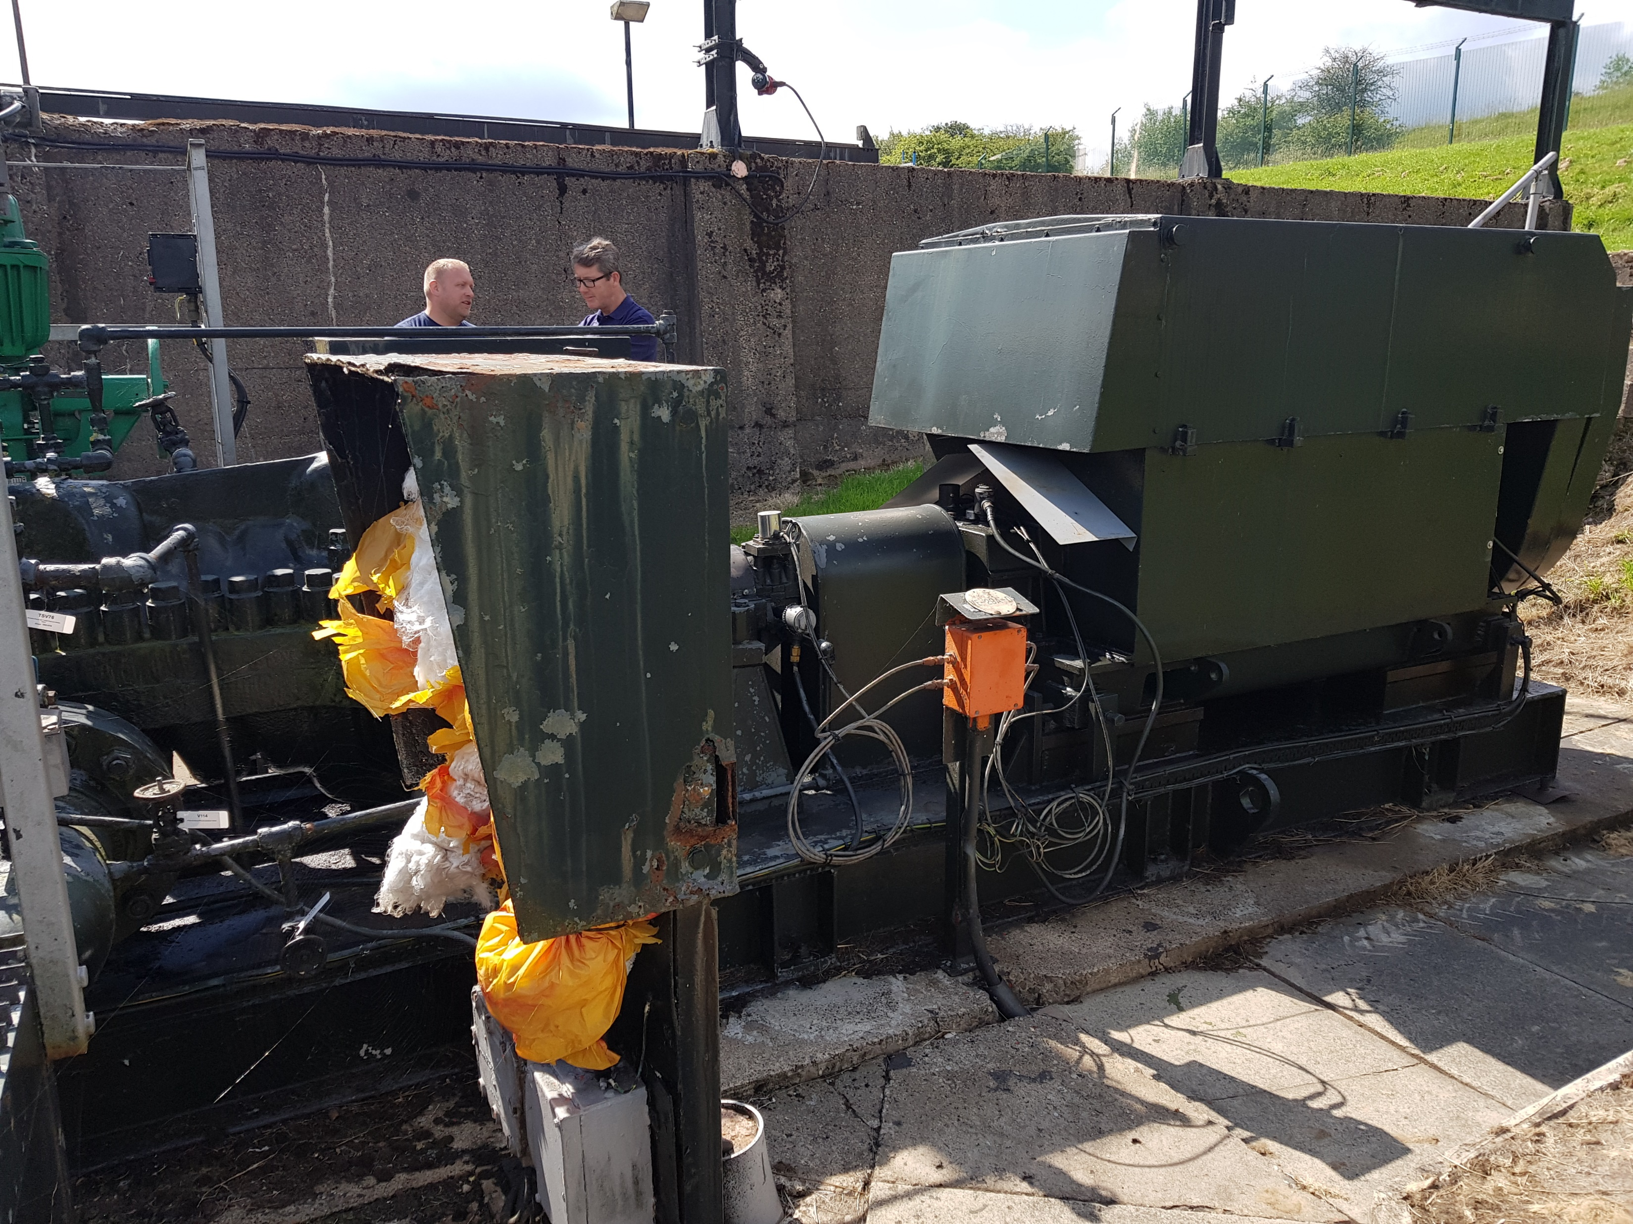
Case Study – Fuel Depot Pump Details
The application detailed below is what the equipment was installed on, and this consists of the following:-
• David Brown 8 stage multi-stage pump, ref:- 6X811B type MSD-D, 2198 ft Head, 1248 GPM (white metal thrust & radial bearings)
• Parsons Peebles 820.0kW, 2965rpm (two pole) HV 3.3kV foot mounted motor (white metal bearings)

Slide 8
Hardware & Platform Details
The Asset Minder platform is written in ThingWorx and was developed by the UK’s leading ThingWorx intergrator – InVMA Ltd based in Chesterfield. ThingWorx is an industrial innovation suite from PTC Corporation.
PTC and Microsoft have partnered to use the scalability of Azure with the deployment speed of ThingWorx to provide a secure and scalable platform, which delivers and;
Monitors IoT endpoints and event streams
Supports a variety of manufacturer and industry proprietary protocols.
Analyses data at the edge and in the cloud
Integrates and engages IT and OT systems in data sharing and consumption
Enables application development and deployment
Enrich and supplement OT functions for improved asset management life cycle strategies and processes
The MachineGuard and Asset Minder installation uses various industrial gateways, from various manufacturers, along with a variety of sensors. These sensors include;
BlueTooth accelerometers (in this case study)
Oil Quality & Temperature sensors
Electrical Signature analysis units
Most instrumentation and sensors

Slide 9

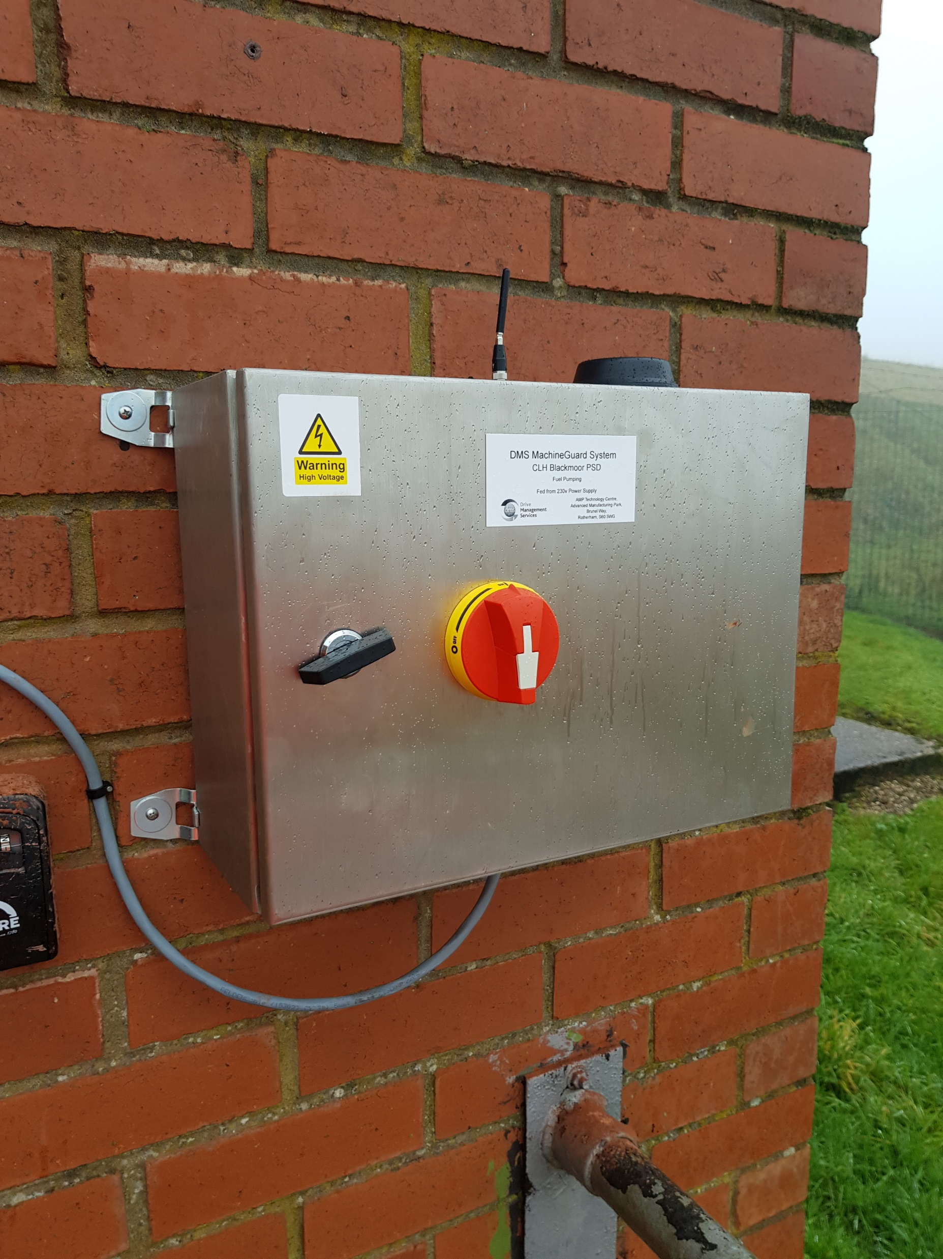
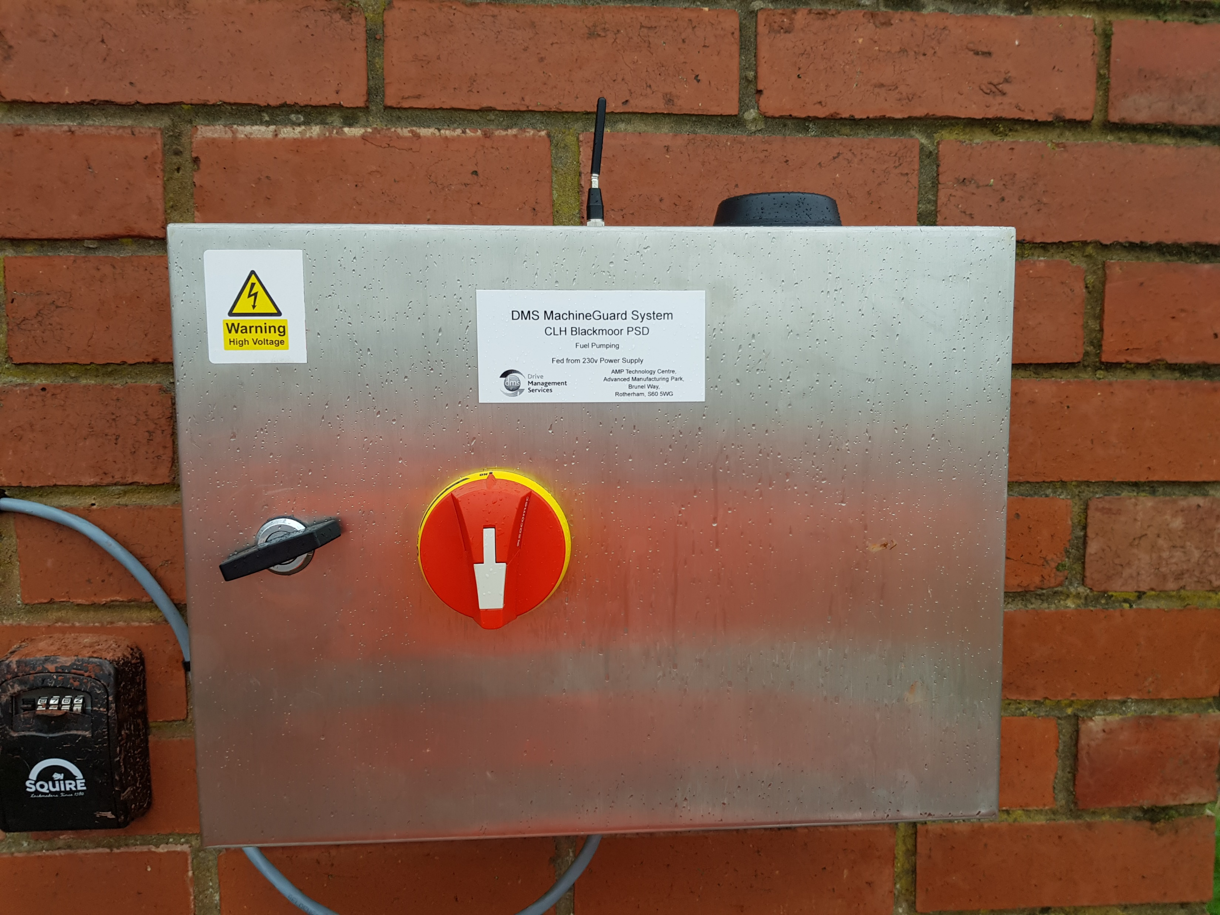
Gateway Enclosures
The MachineGuard and Asset Minder installation uses predominantly the Dell Edge 3000 series gateways.
Other Gateway products are available on request, such as Technexion and Aplicon.
The Dell Gateways are preconfigured using Kepware & Ubuntu, enabling remote connectivity and the capability to amend configurations and additions.
The stainless steel IP67 rated enclosures, supplied are completely assembled with MCB, 24V or 110V power supply, lockable external isolator, WiFi antenna (c/w SMA extension) and a series of GSM / GPRS antennas manufactured by Siretta.
Temperature range -30ºC to +70ºC
The most reliable gateway in the market with highest MTBF
The Gateway is capable of communicating with 299 BluVib accelerometers

Slide 10
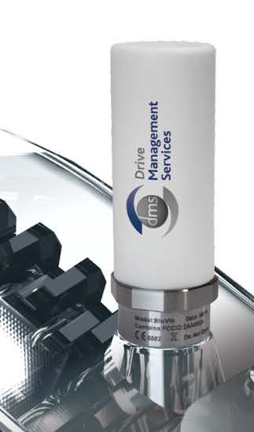
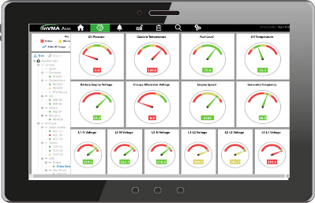
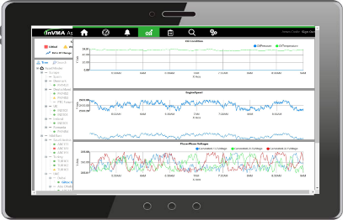
BluVib Accelerometers
Measurement Specification as follows:-
Sensitivity: Programmable (50mV/g, 100mV/g, 200 mV/g, 500mV/g)
Measurement Range: +/-20g at 50mV/g
Frequency Range (+/-3dB): 0.3 to 10000 Hz
Resonant Frequency: 25kHz
Amplitude Linearity: ±1% typical in passband
Dynamic Range: >70dB
Data Acquisition Specification as follows:-
ADC: 16-bit SAR
Sample Rate: Programmable from 256Hz to 25.6kHz
Anti-Aliasing Filter: Compound analog/digital
Data Block Lengths: 64 to 32768 samples
Spectral Line Equivalent: 100 to 12800 lines
Modes: Continuous, Wake Up, Triggered (‘g’ level) Manual wake-up via magnetic switch
Processing & Communications Specification as follows;-
Configuration: Over Radio Network
Programming: Firmware upgrades over radio network
Network: Bluetooth 5 Low Power
Notes:
Bluetooth

Slide 11
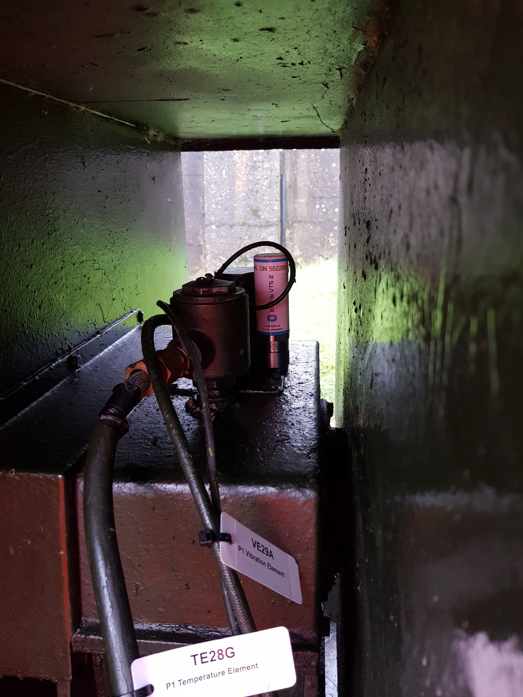
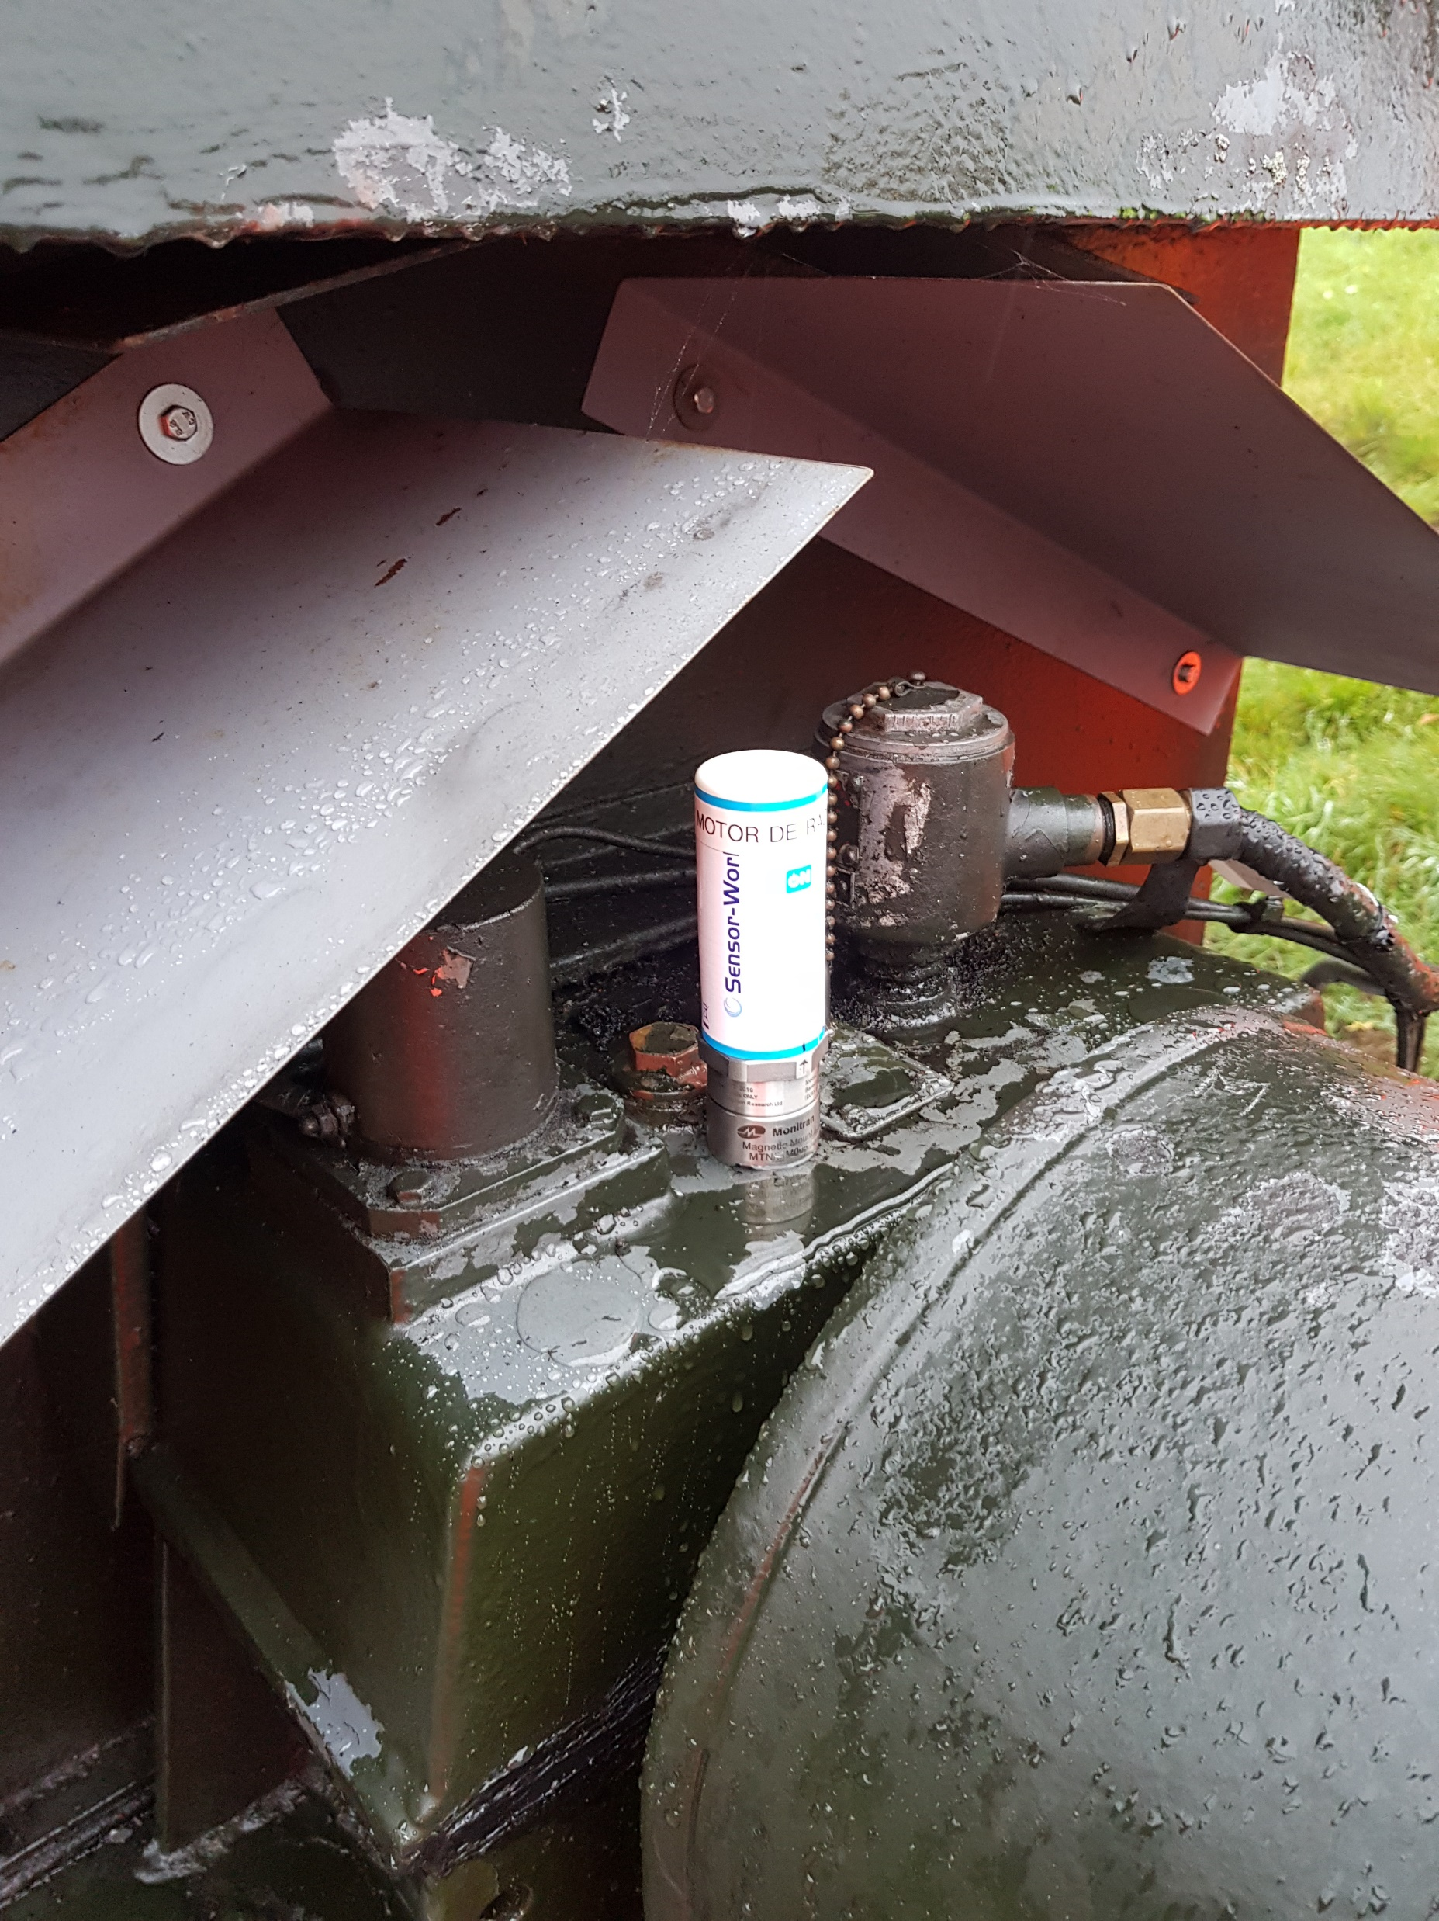
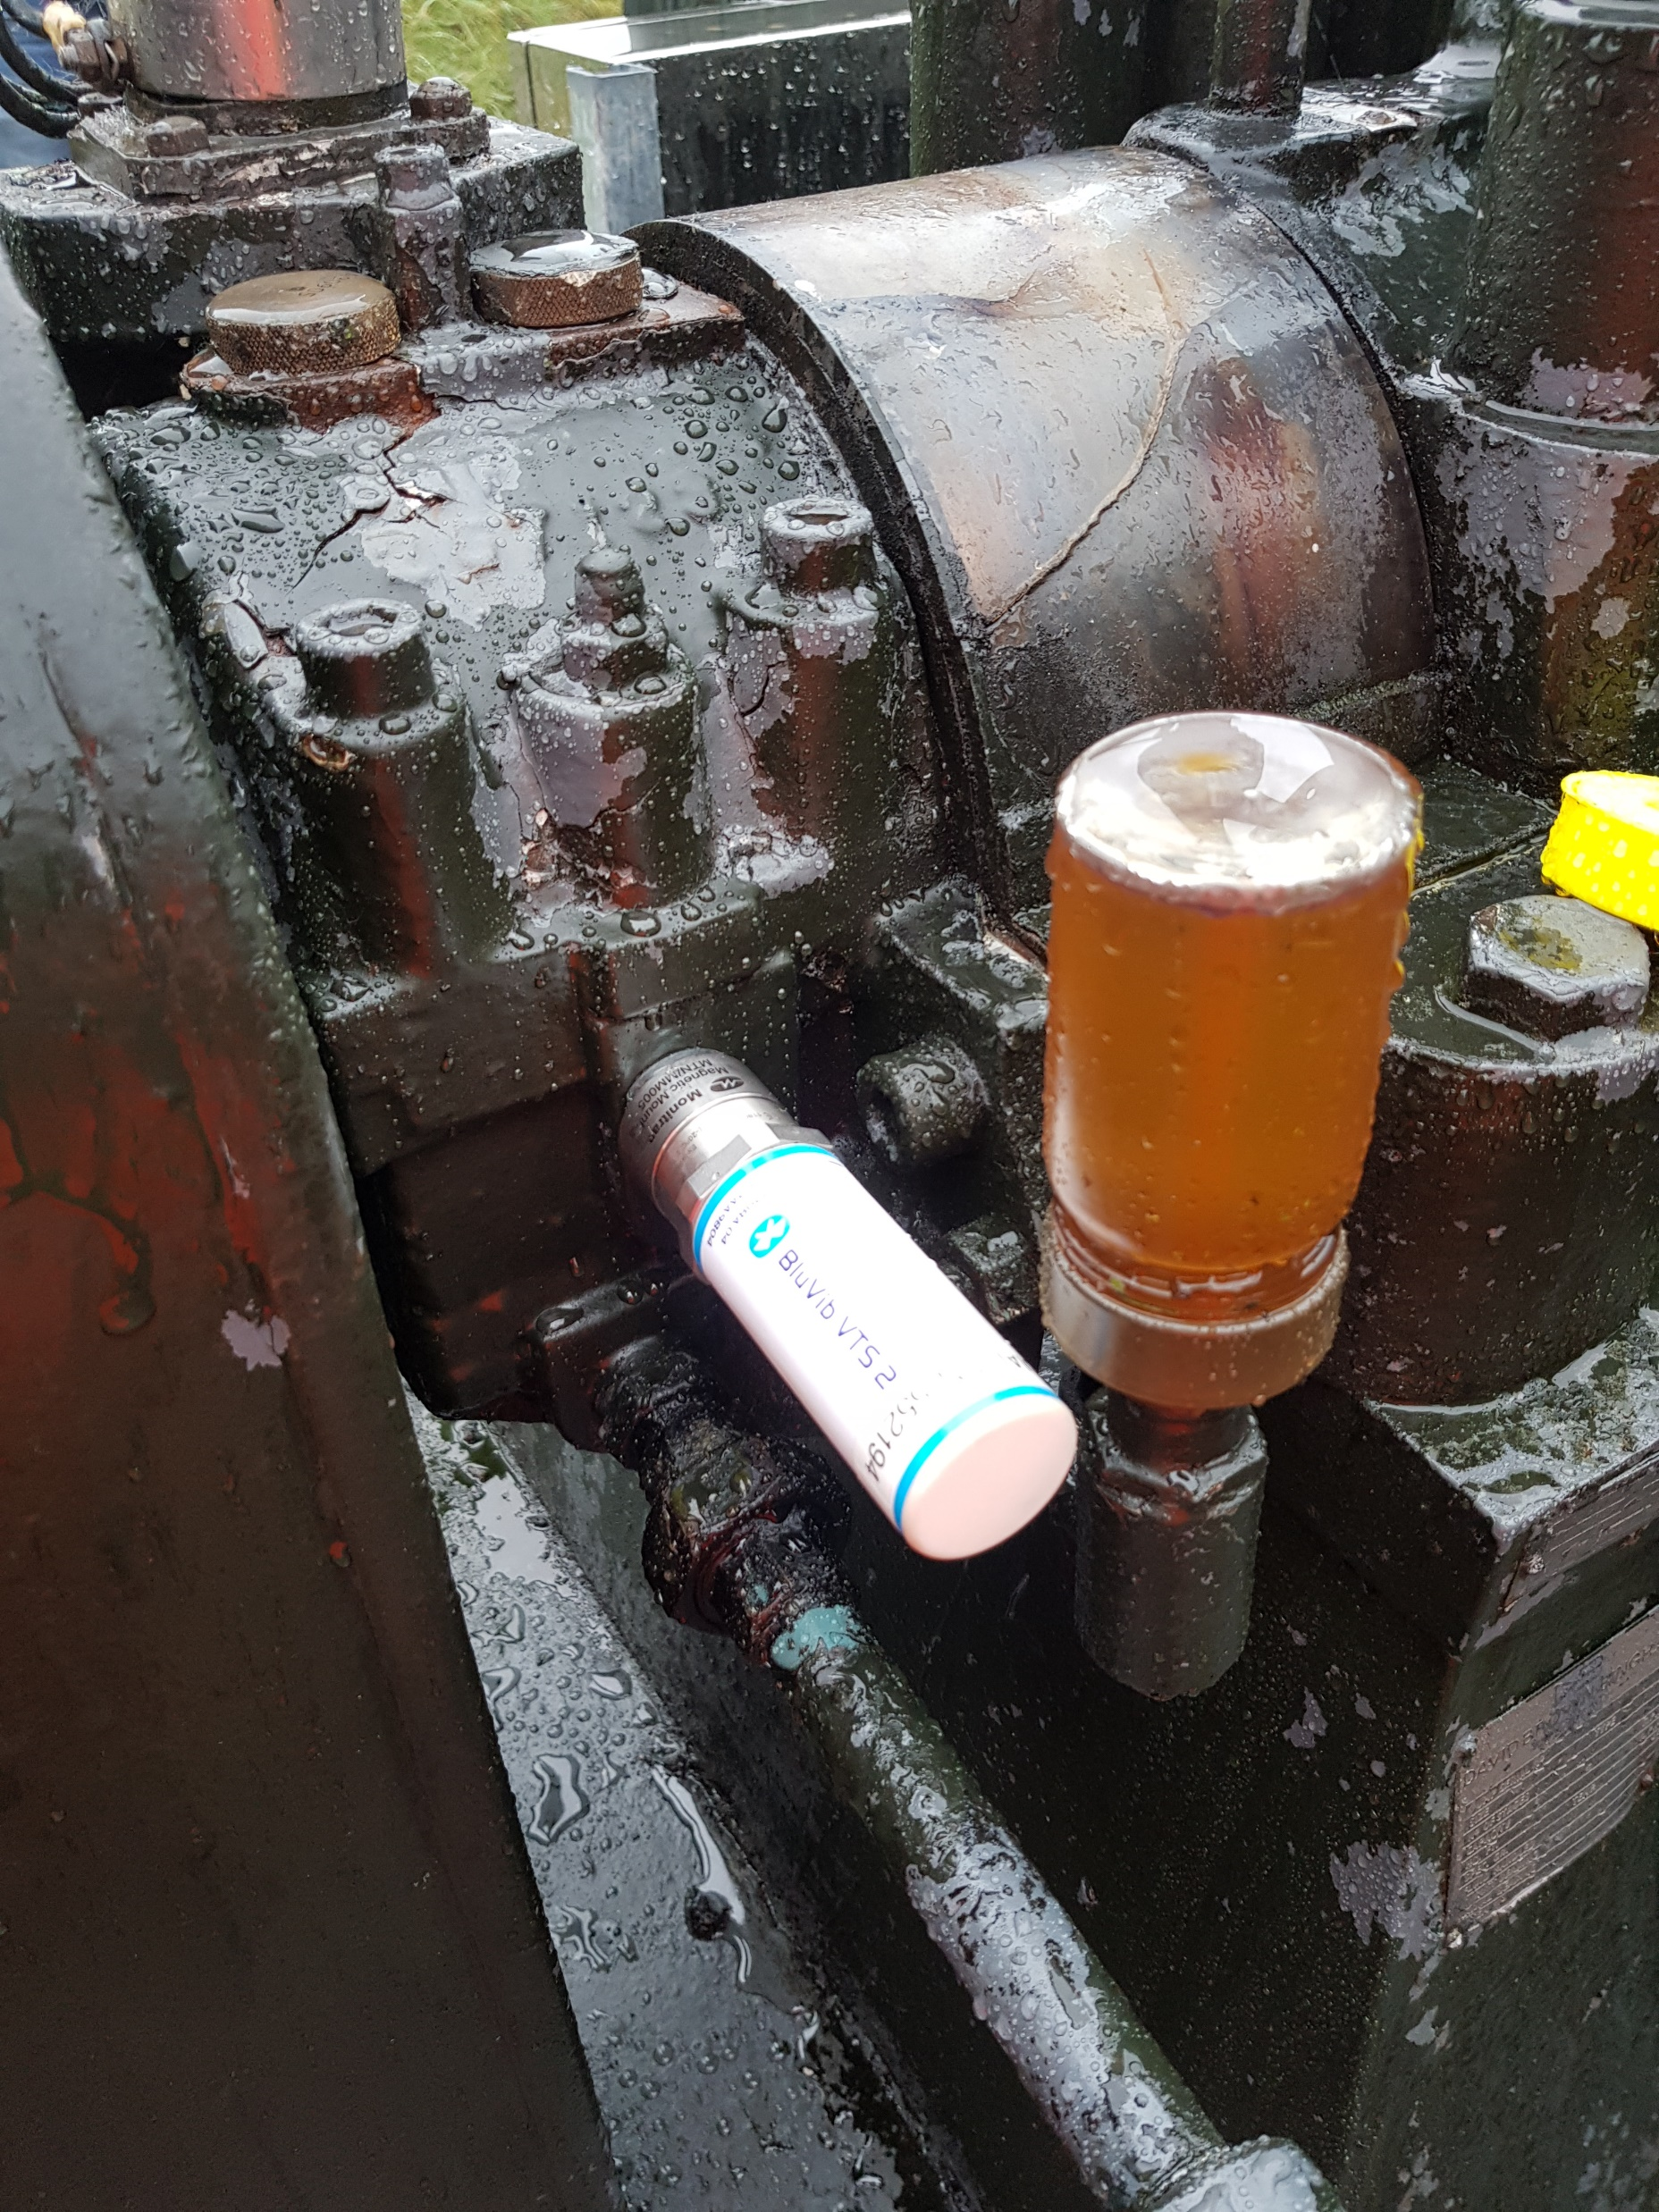
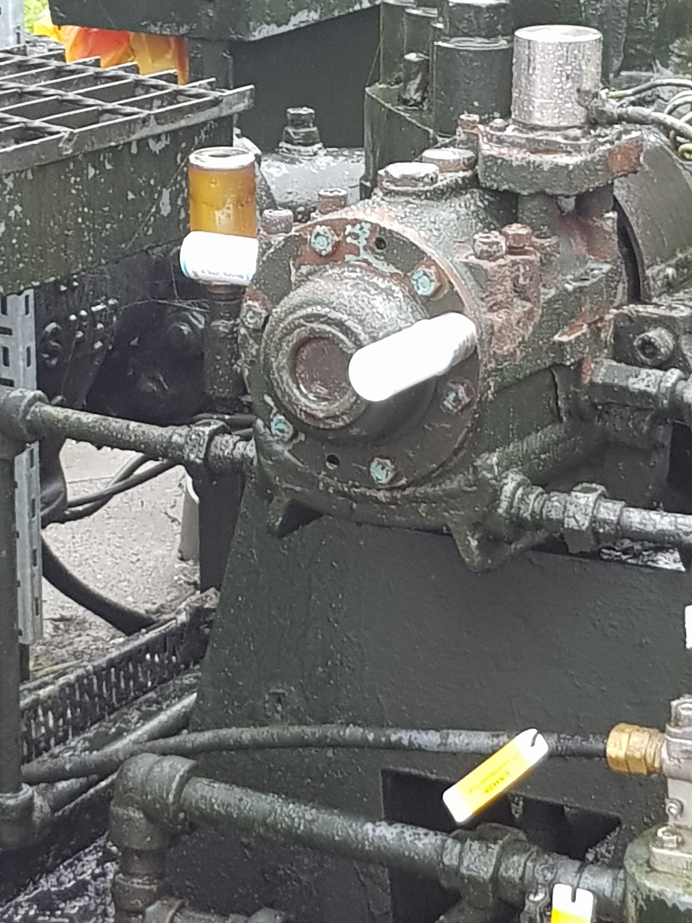
Case Study – Fuel Depot Pump
We installed a system on a fuel depot multi-stage pump in a remote location. DMS installed 5 off ATEX rated Blue Tooth accelerometers. One mounted on each of the motor bearings, with a further 2 off mounted on each of the pump bearings in a radial position, with the final accelerometer mounted on the NDS bearing in axial position.

Slide 12
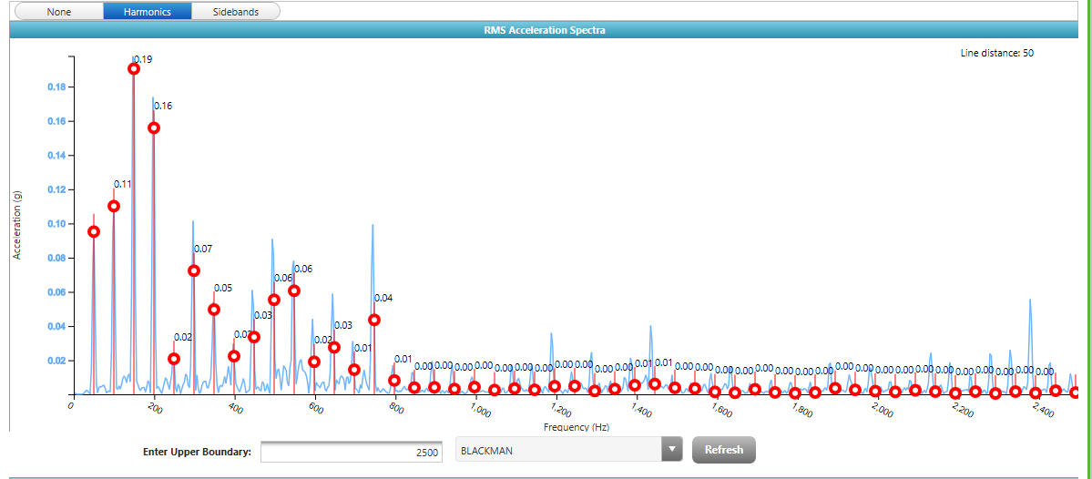
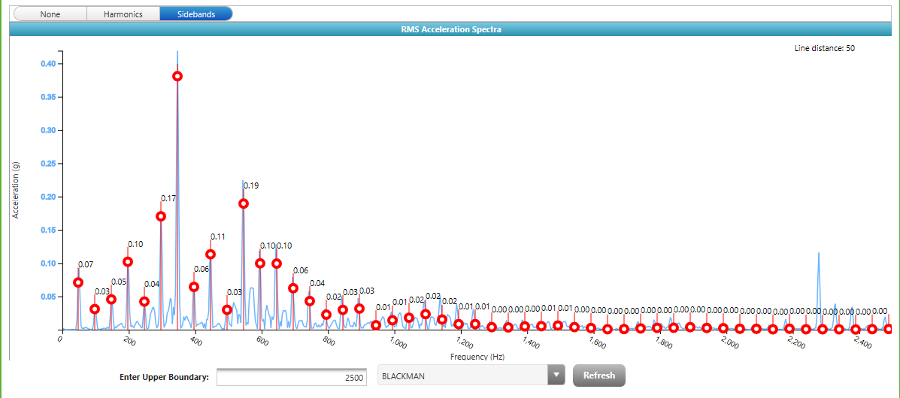
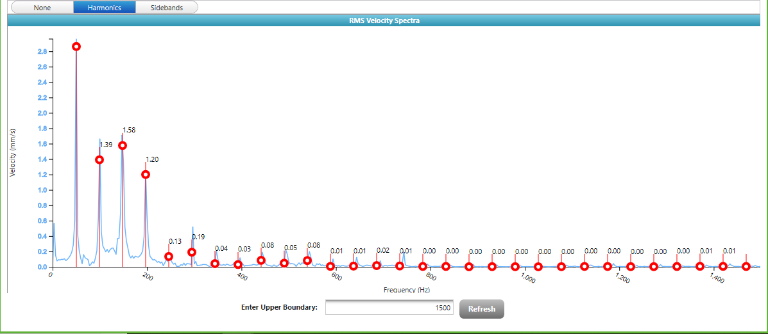
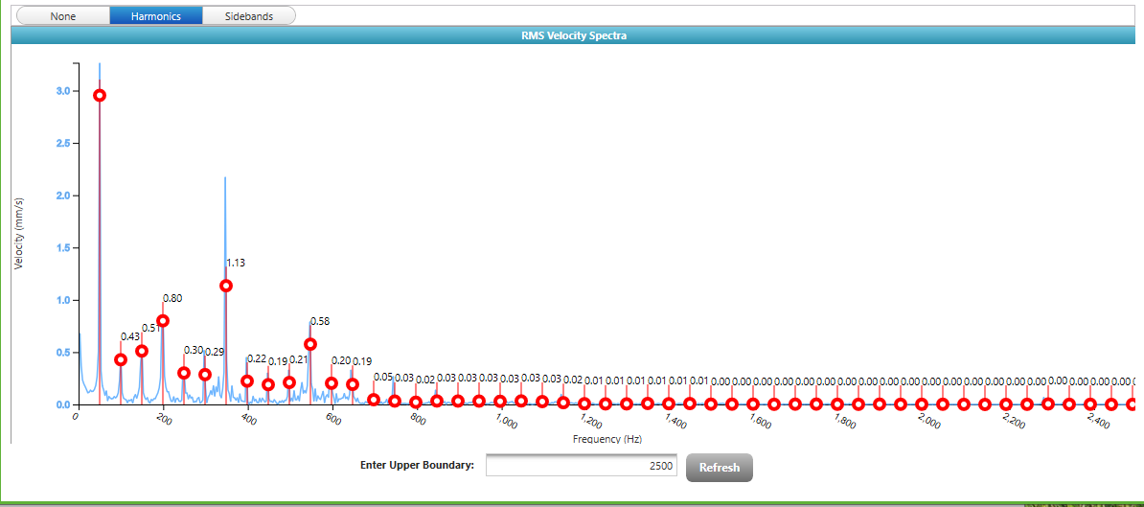
Case Study – Fuel Depot Pump
Motor NDE Acceleration
Motor DE Acceleration
Motor NDE velocity
Motor DE velocity

Slide 13
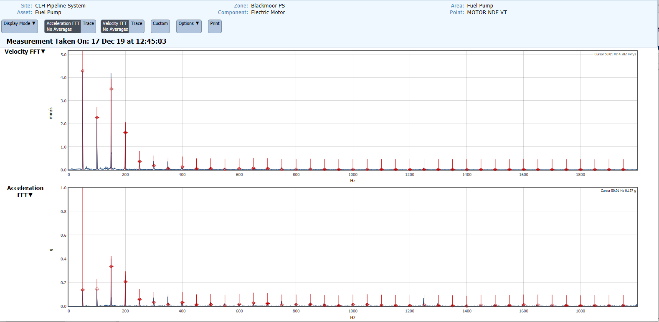
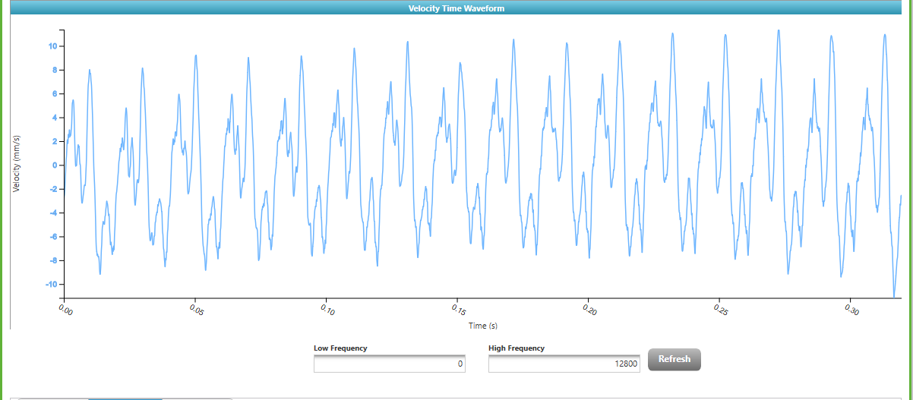
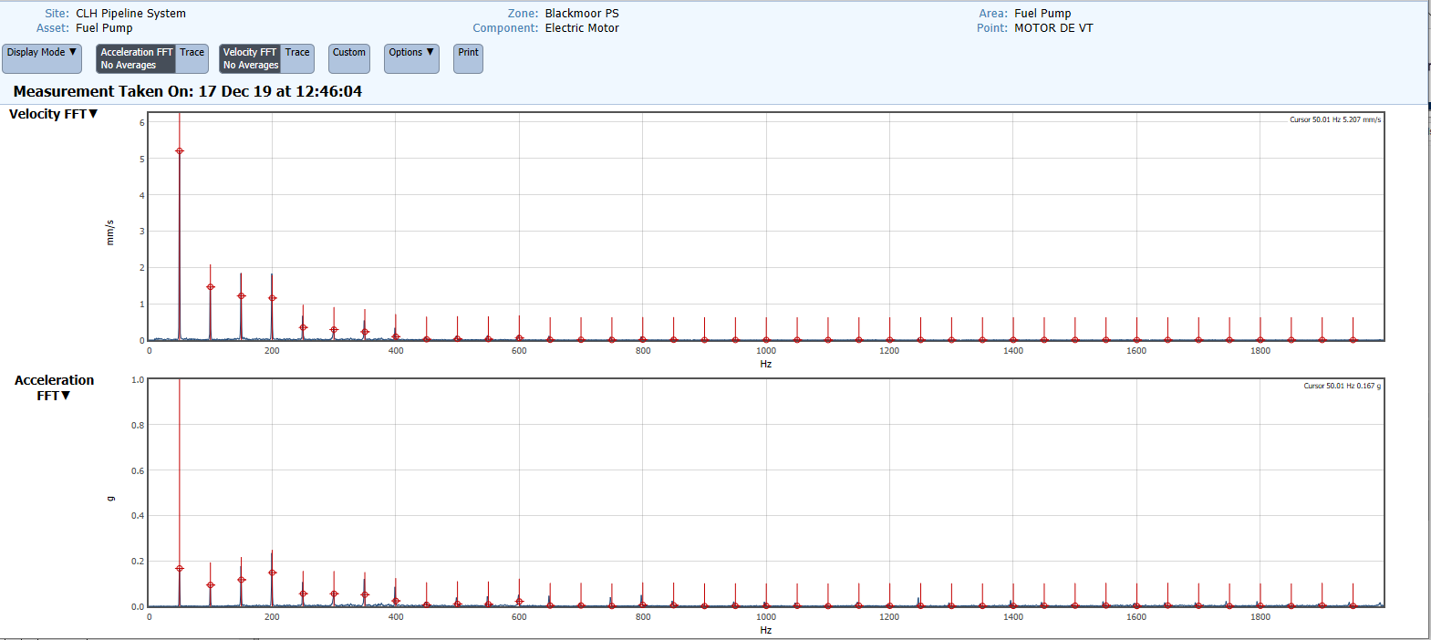
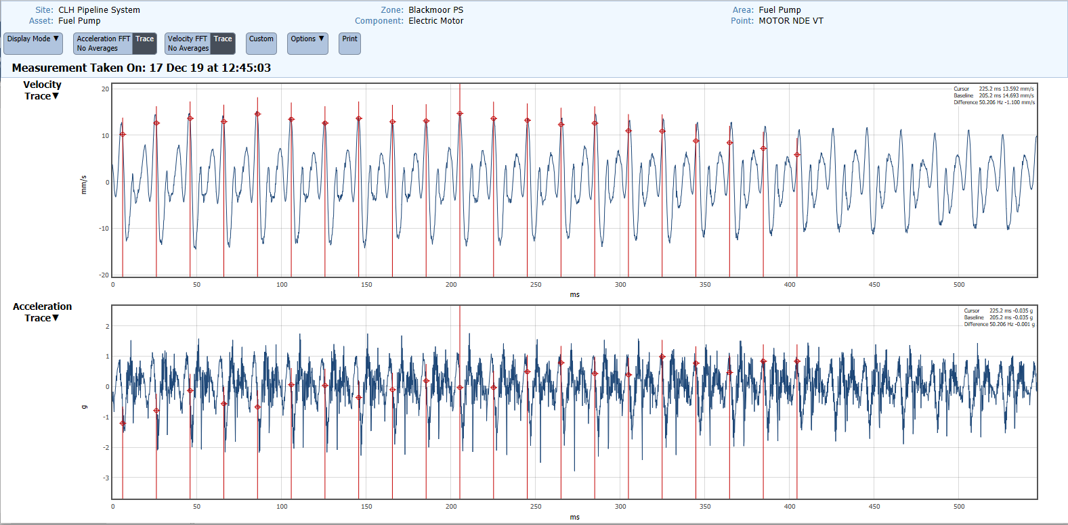
Case Study – Fuel Depot Pump

Slide 14
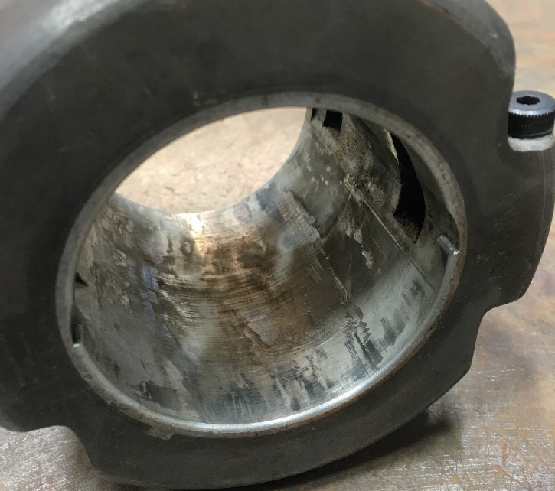
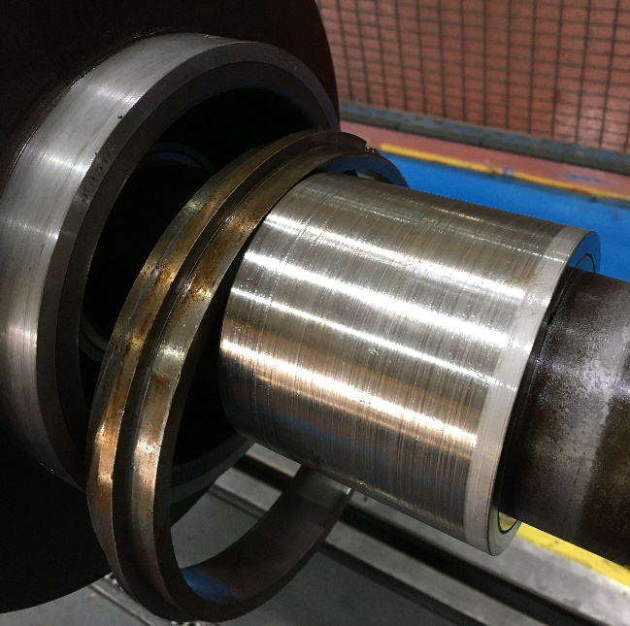
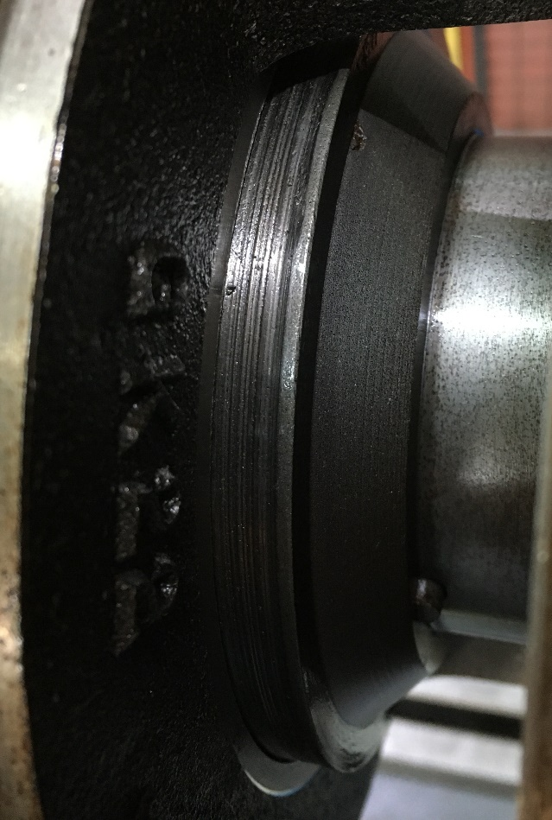
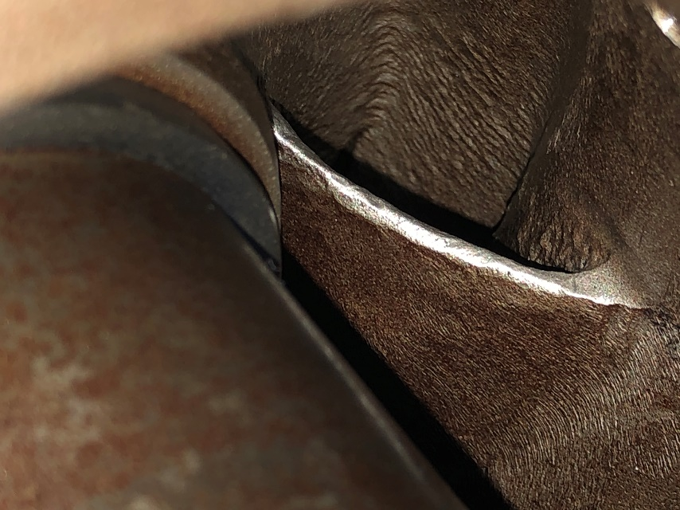
Case Study – Inspection
Image No.17.
Image No.18.
Image No.19.
Image No.20.
An independent engineering repair centre, stripped down and identified the following major issues:-
All white metal babbitted bearings in both the motor & pump were significantly worn & had a progressive loss of white metal across the loaded zone (image no.19).
The pump impellor hub locations are worn & scored (image no.18)
The mechanical seals required a complete refurbishment
The throttle sleeve and bush had worn oversize & had become tapered (image no.17)
The 1st impellor suction had to undergo dressing of the vane tips (image no.20)

Slide 15
Case Study – Root Cause Analysis
The above inspection undertaken at the workshop confirmed that the white metal babbitted radial bearings in both the pump and high voltage AC motor, were significantly worn and had a progressive loss of white metal material over the loaded zone. The removed pump inboard (image no.19. above) white metal babbit bearing displays some heat discolouration and patchy contact, which is normally an indication of a bearing that is oil starved. However, this could be the result of excessive movement in the motor bearings causing the hydrodynamic film to be degraded across the whole assembly.
The impellor hub locations are worn and scored which suggests that the hub has been subjected to excessive radial displacement, which has resulted in the hub “rubbing” against the bush. This is probably the result of the wear identified in all the pump white metal babbit radial bearings.
We know from our experience in vibration analysis that mechanical looseness in induction motors is a common problem caused by loose bolts, structural damage, improper fit, or increased clearance between components, and results in increased vibration and wear. Detection of mechanical looseness in the white metal babbit type sleeve bearings of industrial motors mainly relies on vibration analysis, which has been proven in this report.

Slide 16

Conclusion
We can conclude that from the information and data detailed above in this report that the MachineGuard Asset Minder product / service identified a potential serious issue within the pump and motor drive assembly. Our remote diagnosis, that the white metal bearings were significantly worn was proven to be correct, confirmed by the report generated by the independent engineering repair centre.
The Blue Tooth accelerometers performed exactly as anticipated and produced similar results to those taken with our hand held data-collectors. This accuracy enables our diagnostic engineers to produce remote reports for clients with real confidence.
The Blue Tooth connectivity of the ATEX sensors provided the client with a quick and efficient installation, without interrupting any operational requirements, which was a major advantage. The installation took one man approx. 2 hours including the enclosure mounting, testing & commissioning.
The Blue Tooth accelerometers used in conjunction with the Asset Minder platform was the ideal combination for monitoring these critical assets. The alerts produced by the system (SMS text message & e-mail alert) enabled our office and site based diagnostic engineers to analyse the data quickly and present our findings to the customer. Based on these findings the customer was able to remove the pump & motor assembly from service in a controlled manner.
This early detection enabled the client to eradicate any penalty clauses, reduce the costs associated with a full overhaul and repair normally associated with a catastrophic failure; whilst assisting in maintaining the long term efficiency of the pump assembly.

Slide 17
Thankyou for listening
Do you have any questions?
Presentation by Allan Findlow

